Slide 1
Housing in Orange County, FL
A project for UCF’s Data Analytics & Data Visualization Bootcamp.
Created by: Cindy Gorbas, Elizabeth Jaye, Dinielle Nelson, Robert Perron, and Dolly Vickers

Slide 2
Motivation & Summary

Slide 3
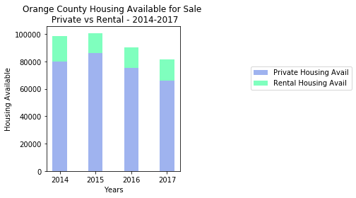
Question 1: Availability

Slide 4
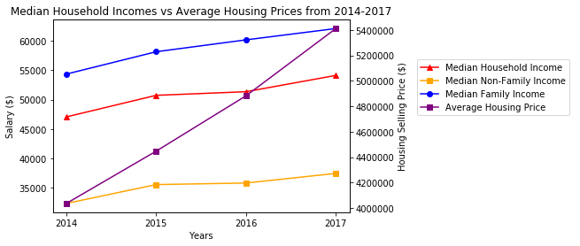
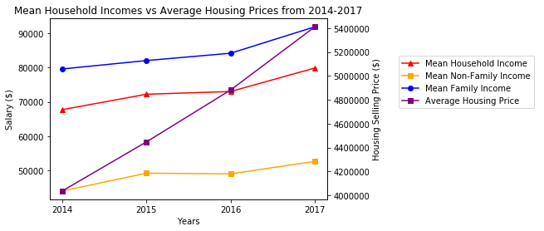
Question 2: Affordability

Slide 5
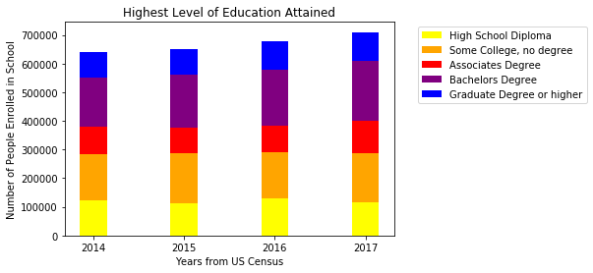
Question 3: Demographic Changes
Education

Slide 6
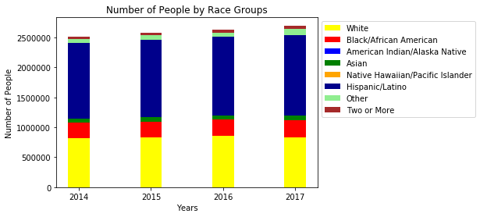
Question 3: Demographic Changes
Race

Slide 7
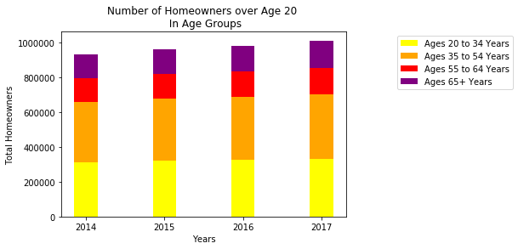
Question 3: Demographic Changes
Age Range

Slide 8
Data Cleanup & Exploration
Methods of getting the data
Exploring, limiting in range etc.
Any interesting findings?

Slide 9
Post Mortem
Discuss any difficulties that arose, and how you dealt with them
Discuss any additional questions that came up, but which you didn't have time to answer: What would you research next, if you had two more weeks?
Basically acknowledge limitations

Slide 10
Questions & Answers

